Slide 1
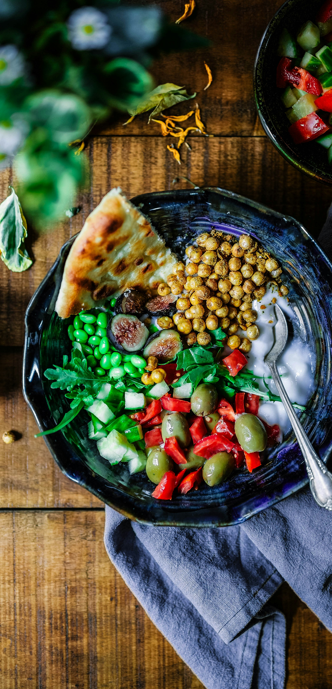


Dine&Dash
Amrita Dubey
Jia Xu

Slide 2
Business Goal
The goal of the Dine & Dash application is to serve as an efficient and modern digital platform for a restaurant to enhance its operations and customer experience. It aims to provide a seamless online ordering solution for the restaurant's customers, enabling them to browse the menu, place orders, and complete secure payments. By digitizing the ordering process, the application helps the restaurant optimize its operations, reduce manual errors, and improve customer satisfaction.

Slide 3
Key Objectives:
Enhance Operational Efficiency:
Minimize order mismanagement by digitizing the order-taking process.
Enable streamlined order tracking and inventory management.
Improve Customer Experience:
Offer a user-friendly interface for customers to explore the restaurant's menu and customize orders easily.
Provide real-time order updates and a secure payment system.
Boost Restaurant Revenue:
Increase the restaurant’s reach by providing a convenient way for customers to place orders.

Slide 4
Target Users
Restaurant Customers:
Regular patrons of the restaurant who want a faster and more convenient way to order food.
Local diners looking for online ordering options with personalized meal customizations.
Tech-savvy customers who prefer digital solutions for food ordering.
Restaurant Staff:
Employees managing order processing and food preparation, benefiting from clear and error-free order details.
Managers who oversee operations and require insights into order trends and customer preferences.
Restaurant Management:
Owners or managers looking to modernize their service and improve operational efficiency.
Decision-makers aiming to attract more customers and boost customer satisfaction through technology.

Slide 5
Future Enhancements:
AI-Powered Recommendations
Integrate a chatbot where user can interact and ask questions and suggestion on menu items based on user preferences, dietary restrictions, and previous orders.
Advanced Analytics for Restaurant Management
Provide a dashboard for restaurant owners to view sales trends, popular menu items, and customer demographics.
Implement predictive analytics to forecast demand and optimize inventory.

Slide 6
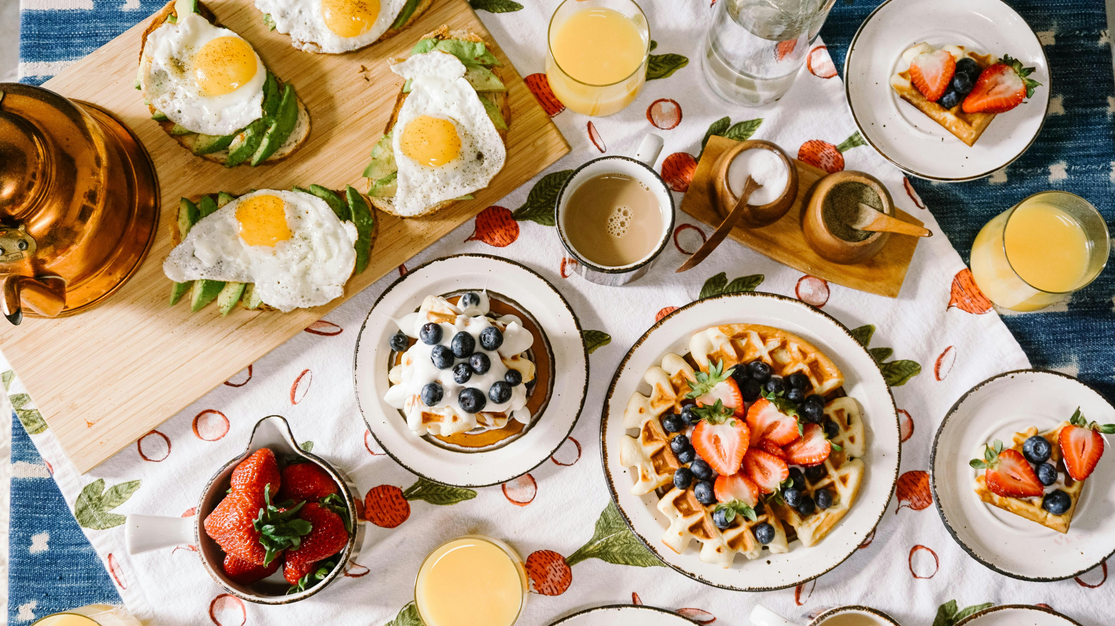
Thank You

